Slide 1
Loops

Slide 2
Loops
Life is full of routines. In programming we also do lots of repetitive tasks. In order to handle repetitive task programming languages use loops. Python programming language also provides the following types of two loops:
while loop
for loop

Slide 3
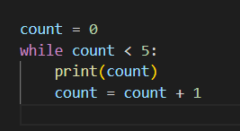
While Loop
We use the reserved word while to make a while loop. It is used to execute a block of statements repeatedly until a given condition is satisfied. When the condition becomes false, the lines of code after the loop will be continued to be executed.

Slide 4
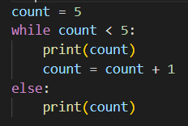
In the above while loop, the condition becomes false when count is 5. That is when the loop stops. If we are interested to run block of code once the condition is no longer true, we can use else.
The above loop condition will be false when count is 5 and the loop stops, and execution starts the else statement. As a result 5 will be printed.

Slide 5
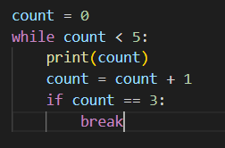
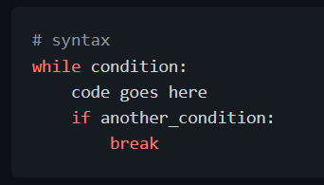
Break and Continue
Break: We use break when we like to get out of or stop the loop.
The above while loop only prints 0, 1, 2, but when it reaches 3 it stops.

Slide 6
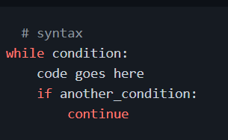
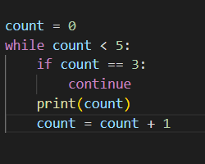
Continue: With the continue statement we can skip the current iteration, and continue with the next:
The above while loop only prints 0, 1, 2 and 4 (skips 3).

Slide 7
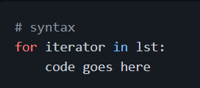
For Loop
A for keyword is used to make a for loop, similar with other programming languages, but with some syntax differences. Loop is used for iterating over a sequence (that is either a list, a tuple, a dictionary, a set, or a string).
For loop with list:

Slide 8
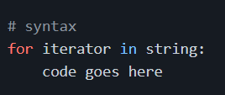
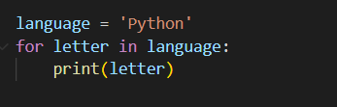
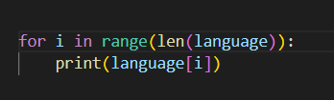
For loop with string

Slide 9
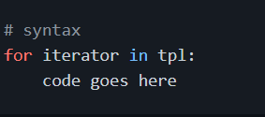
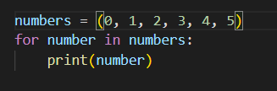
For loop with tuple

Slide 10
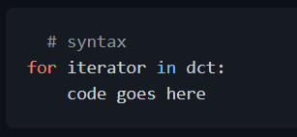
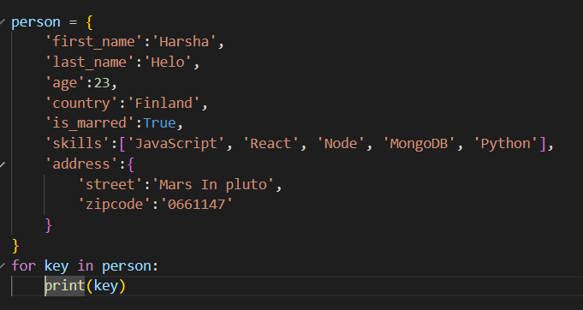
For loop with dictionary Looping through a dictionary gives you the key of the dictionary.

Slide 11
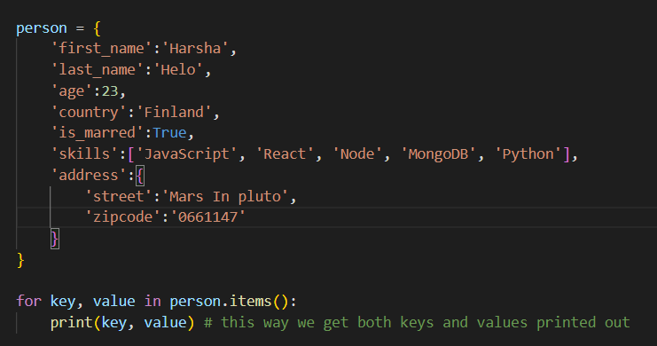

Slide 12
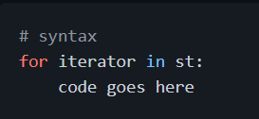
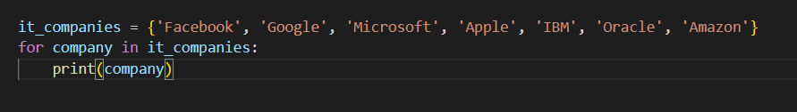
Loops in set

Slide 13
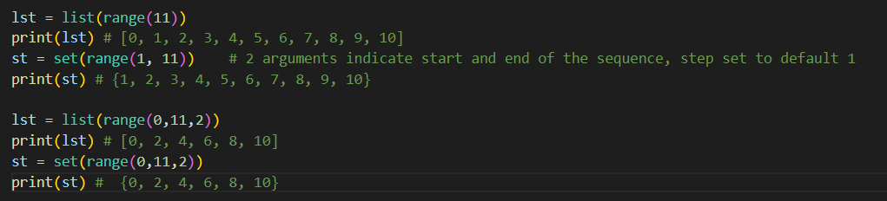
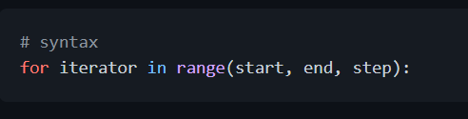
The Range Function
The range() function is used list of numbers. The range(start, end, step) takes three parameters: starting, ending and increment. By default it starts from 0 and the increment is 1. The range sequence needs at least 1 argument (end). Creating sequences using range

Slide 14
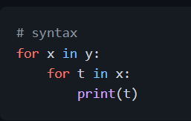
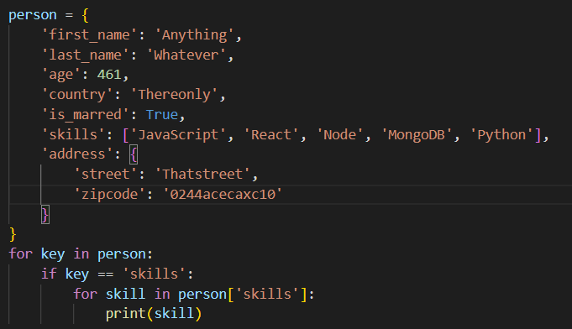
Nested For Loop
We can write loops inside a loop.

Slide 15
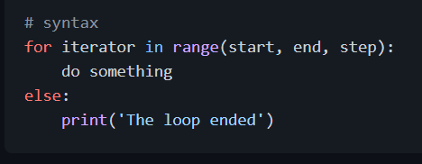
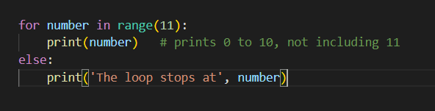
For Else
If we want to execute some message when the loop ends, we use else.

Slide 16
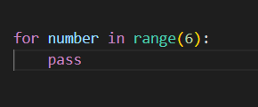
Pass
In python when statement is required (after semicolon), but we don't like to execute any code there, we can write the word pass to avoid errors. Also we can use it as a placeholder, for future statements.

Slide 17
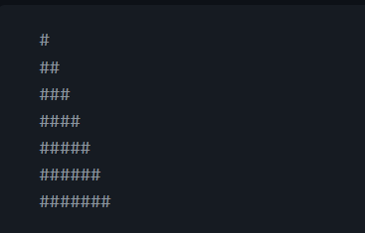
💻 Exercises: Day 10 Exercises: Level 1
Iterate 0 to 10 using for loop, do the same using while loop.
Iterate 10 to 0 using for loop, do the same using while loop.
Write a loop that makes seven calls to print(), so we get on the output the following triangle:

Slide 18
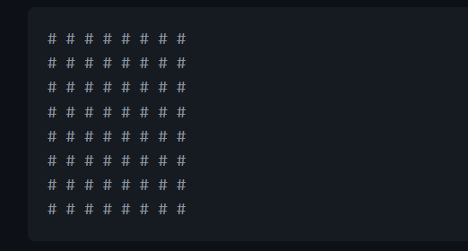
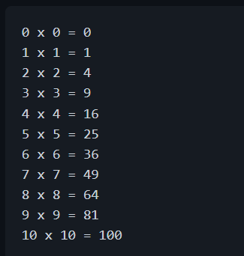
Use nested loops to create the following:
Print the following pattern:

Slide 19
Iterate through the list, ['Python', 'Numpy','Pandas','Django', 'Flask'] using a for loop and print out the items.
Use for loop to iterate from 0 to 100 and print only even numbers
Use for loop to iterate from 0 to 100 and print only odd numbers

Slide 20


Exercises: Level 2
Use for loop to iterate from 0 to 100 and print the sum of all numbers.
Use for loop to iterate from 0 to 100 and print the sum of all evens and the sum of all odds.

Slide 21
Exercises: Level 3
Go to the data folder and use the countries.py file. Loop through the countries and extract all the countries containing the word land.
This is a fruit list, ['banana', 'orange', 'mango', 'lemon'] reverse the order using loop.
Go to the data folder and use the countries_data.py file.
What are the total number of languages in the data
Find the ten most spoken languages from the data
Find the 10 most populated countries in the world

